Slide 1
Lesson 2
Genre - Meaning and Main Types

Slide 2
Let’s Define ‘Genre’
Genre a particular type of writing, movies, music etc, which has certain features that all examples of this type share.
particular type of writing
which has certain features
  that all writing of this type share

Slide 3
Genre
Genre a particular type of writing, movies, music etc, which has certain features that all examples of this type share.

Slide 4
Genre
Genre a particular type of writing, movies, music etc, which has certain features that all examples of this type share.
MOVIES
action
comedy
thriller
romance
fantasy
biopic

Slide 5
Genre
Genre a particular type of writing, movies, music etc, which has certain features that all examples of this type share.
MOVIES
action
comedy
thriller
romance
fantasy
biopic
MUSIC
jazz
pop
classical
Carnatic
Hindustani
metal

Slide 6
Genre
Genre a particular type of writing, movies, music etc, which has certain features that all examples of this type share.
MOVIES
action
comedy
thriller
romance
fantasy
biopic
MUSIC
jazz
pop
classical
Carnatic
Hindustani
metal
WRITING
science fiction
biography
graphic novel
mystery
historical fiction
fantasy

Slide 7
Genre is ONE way to classify books.
Books can be classified in many ways. Genre is just one way to do it.
Other ways can use:
  alphabetical order of title or author name,
  size,
  themes in the book,
  language,
  popularity, or
  even colours!

Slide 8
Genre ≠ Theme
A horror story can have the theme of love (the lovers may visit a grave for a date and something sinister may happen there)
AND
A romantic novel can have the theme of love (two people fall in love and eventually get married)
AND
A comedy can have the theme of love (romantic comedy - few obstacles on their way, lots of jokes and funny situations, followed by a happy ending)
Notes:
Optional Video: https://www.youtube.com/watch?v=h49WI9bYOjI

Slide 9
The Three Main Genres in Writing
Poetry
Drama / Play - contains dialogues and stage directions
Prose - has complete sentences and is organized into paragraphs
  Fiction - literature with imaginary events and people
  Nonfiction - writing about something that is factual

Slide 10
An Important Aside
Nonfiction - writing about something that is factual.
This does not mean everything in nonfiction is correct and true.
In the words of Joe Sutliff Sanders,
the author of Literature of Questions: Nonfiction for the Critical Child,
“Nonfiction is written by human beings. Imperfections, mistakes, and bias are inevitable, which means that insofar as it is ever a literature of facts, it is a literature of facts laced with error.”

Slide 11
Each of these have further subtypes.
Poetry
Drama / Play - contains dialogues and stage directions
Prose - has complete sentences and is organized into paragraphs
  Fiction - literature with imaginary events and people
  Nonfiction - writing about something that is factual

Slide 12
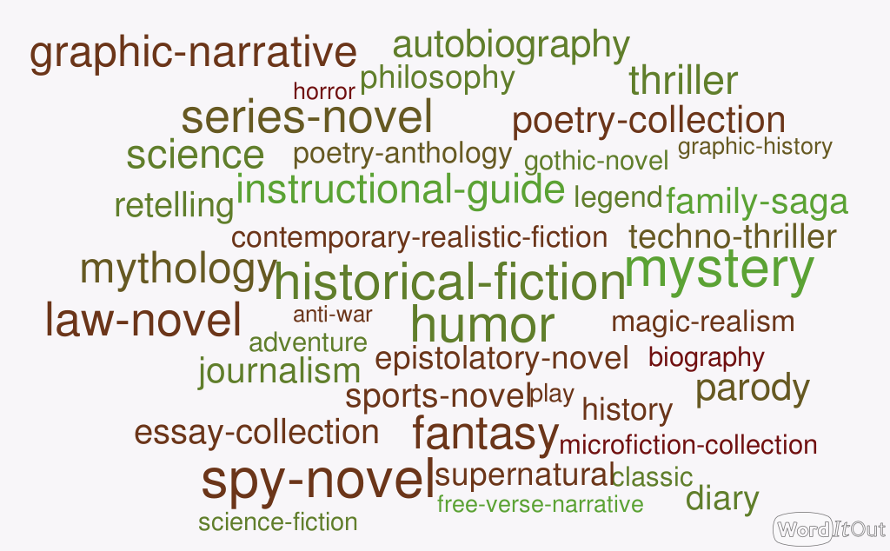

Slide 13
Can a piece of writing belong to multiple genres?
Every library makes its own rules to decide where to place a book like Charlie and the Chocolate Factory.
YES!
For example, Charlie and the Chocolate Factory can be classified as
Children's literature and
Fantasy

Slide 14
In our library,
Notes:
Blank slide for you to add how your library does the classification.

Slide 15
How do you identify the genre of a book?
The easy part is to differentiate among the main genres.
Poetry
Drama / Play - contains dialogues and stage directions
Prose - has complete sentences and is organized into paragraphs
  Fiction - literature with imaginary events and people
  Nonfiction - writing about something that is factual

Slide 16
To be more precise about genre
For example, to know whether a book is historical fiction or realistic fiction; or if it is a dystopian novel or a science fiction novel, you need to know TWO things:
The book itself (the blurb is sometimes enough)
  Characterization
  Setting
  Plotline
The defining characteristics of the genres in question
To be continued . . .
Adapted from the work of Glenn Powers, CTL

