Slide 1
Lesson 3
Realistic Fiction vs. Fantasy vs. Historical Fiction

Slide 2
Fiction
Fiction is literature with imaginary events and people.
However imaginary these events and people are, fiction is often inspired by reality.
After all, the creators of fiction are all human in the real world and are constantly drawing from their observations and experiences.
Even when humans are flying and animals are talking (Fantasy), the themes are so relatable to us because it is still a version of human reality even if it’s in a different context.

Slide 3
All fiction is imaginary.
All fiction may be inspired by reality (in one way or another).
Some fiction is based on true stories.
fiction
based on true stories

Slide 4
When fiction is not based on true stories,
It is easier to identify the genre:
If it has elements of fantasy (flying humans, talking animals, magic) = fantasy
It if is realistic (obeys the science of the real world) = realistic fiction
fiction
based on true stories

Slide 5
When fiction is based on true stories,
it can get confusing.
The story could be about
about events that have happened or are happening
about people who have lived or are living
Is it still realistic fiction?
When is it historical fiction?
fiction
based on true stories

Slide 6
Definitions first. Examples later.
Realistic fiction is a genre of stories that are
imaginary but with realistic characters
imaginary but with a realistic setting (time and place)
imaginary but with a realistic plot
realistic = resembles real life; believable; could very well happen in real life to someone in some place at some time

Slide 7
Definitions first. Examples later.
Historical fiction is a genre of stories that are
imaginary but with realistic characters
real setting (time and place)
real events from history
  that feature in the plot and
  are critical to the storyline
Historical fiction is also realistic.
realistic = resembles real life; believable; could very well happen in real life to someone in some place

Slide 8
Definitions first. Examples later.
Historical fiction is also realistic.
realistic = resembles real life; believable; could very well happen in real life to someone in some place at some time
historically realistic = resembles real life; believable; could have very well happened in real life to someone in a particular place at a real historical time,
but, still imaginary.

Slide 9
Historical Fiction
A book can be identified as historical fiction if it satisfies 3 conditions:
It must be set in history (at the time of creation).
A significant historical event/person must be at the center of the plot.
The significant historical event/person must play a major role in the plot/conflict.

Slide 10
Now, examples.
Watch all the trailers first.
Let’s discuss at the end.
Bajirao Mastani (2015)
Gully Boy (2019)
Band Baaja Baarat (2010)
Awaara (1951)
Short discussion
Bajirao Mastani - Historical Fiction
Gully Boy - Realistic Fiction based on true stories
Band Baaja Baarat - Realistic Fiction
Awaara - Realistic Fiction

Slide 11
More examples.
Uri (2019, the uri attack happened in 2016)
  The makers say that it is a slightly fictionalized account of the Uri attack. Mostly nonfiction. (Remember - Nonfiction is not always accurate.)
Raazi (2018, the story is set in 1971)
  Fiction based on a true story - the author of the book Calling Sehmat, Harinder Sikka has categorized his book as fiction based on real events.
Kedarnath (2018, the floods happened in 2013)
  Historical fiction

Slide 12
Let’s look at books from our library.

Slide 13
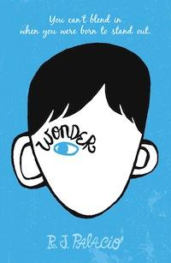
I won't describe what I look like. Whatever you're thinking, it's probably worse.
August (Auggie) Pullman was born with a facial deformity that prevented him from going to a mainstream school - until now. He's about to start 5th grade at Beecher Prep, and if you've ever been the new kid then you know how hard that can be. The thing is Auggie's just an ordinary kid, with an extraordinary face. But can he convince his new classmates that he's just like them, despite appearances?

Slide 14
Realistic Fiction

Slide 15
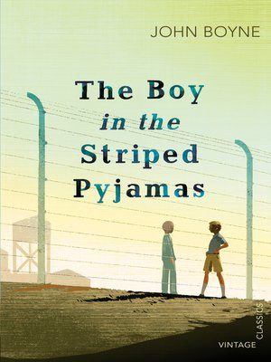
Berlin 1942
When Bruno returns home from school one day, he discovers that his belongings are being packed in crates. His father has received a promotion and the family must move from their home to a new house far far away, where there is no one to play with and nothing to do. A tall fence running alongside stretches as far as the eye can see and cuts him off from the strange people he can see in the distance.
But Bruno longs to be an explorer and decides that there must be more to this desolate new place than meets the eye. While exploring his new environment, he meets another boy whose life and circumstances are very different to his own, and their meeting results in a friendship that has devastating consequences.

Slide 16
Historical Fiction

Slide 17
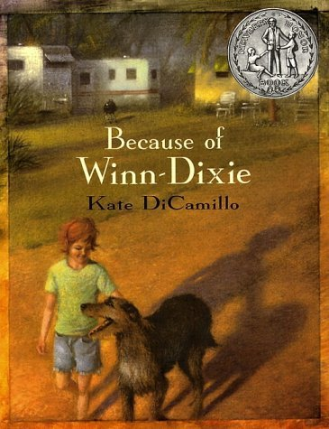
The summer Opal and her father, the preacher, move to Naomi, Florida, Opal goes into the Winn-Dixie supermarket and comes out with a dog. A big, ugly, suffering dog with a sterling sense of humor. A dog she dubs Winn-Dixie. Because of Winn-Dixie, the preacher tells Opal ten things about her absent mother, one for each year Opal has been alive. Winn-Dixie is better at making friends than anyone Opal has ever known, and together they meet the local librarian, Miss Franny Block, who once fought off a bear with a copy of War and Peace. They meet Gloria Dump, who is nearly blind but sees with her heart, and Otis, an ex-con who sets the animals in his pet shop loose after hours, then lulls them with his guitar. Opal spends all that sweet summer collecting stories about her new friends, and thinking about her mother. But because of Winn-Dixie or perhaps because she has grown, Opal learns to let go, just a little, and that friendship-and forgiveness-can sneak up on you like a sudden summer storm.

Slide 18
Realistic Fiction

Slide 19
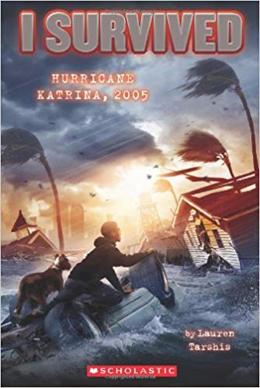
The horror of Hurricane Katrina is brought vividly to life in this fictional account of a boy, a dog, and the storm of the century.
Barry's family tries to evacuate before Hurricane Katrina hits their home in New Orleans. But when Barry's little sister gets terribly sick, they're forced to stay home and wait out the storm.
At first, Katrina doesn't seem to be as bad as predicted. But overnight the levees break, and Barry's world is literally torn apart. He's swept away by the floodwaters, away from his family. Can he survive the storm of the century - alone?

Slide 20
Historical Fiction

Slide 21
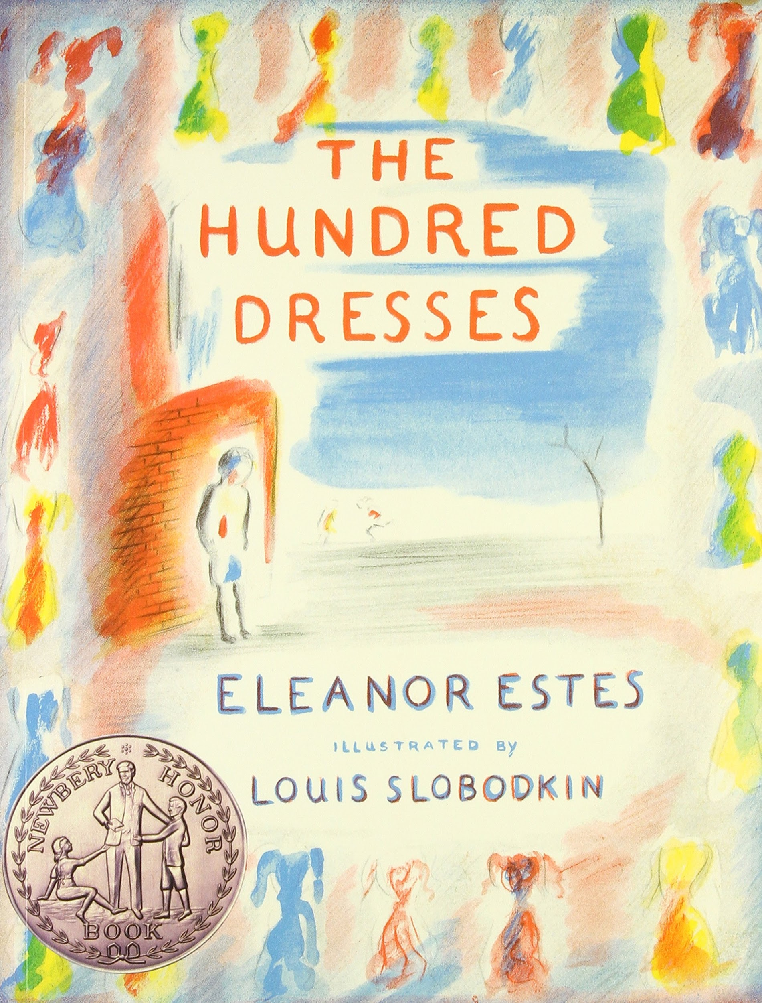
Eleanor Estes’s The Hundred Dresses won a Newbery Honor in 1945 and has never been out of print since. At the heart of the story is Wanda Petronski, a Polish girl in a Connecticut school who is ridiculed by her classmates for wearing the same faded blue dress every day. Wanda claims she has one hundred dresses at home, but everyone knows she doesn’t and bullies her mercilessly. The class feels terrible when Wanda is pulled out of the school, but by that time it’s too late for apologies. Maddie, one of Wanda’s classmates, ultimately decides that she is "never going to stand by and say nothing again."

Slide 22
Realistic Fiction

Slide 23
Look at books you have borrowed currently
Share with the class the books that are historical fiction or realistic fiction.

Slide 24
How does this matter?
Turn and Talk:
How will my reading experience change if I know that the book belongs to historical fiction (and not realistic fiction)?
What can I gain as a reader by reading historical fiction?
What should I change in the way I have been reading historical fiction?

Slide 25
Let’s recap and wrap up.
Redraw the diagram below to reflect your current understanding of the difference between historical fiction and realistic fiction.
OR
write the similarities and
differences between
realistic fiction and
historical fiction.
fiction
based on true stories

Slide 26
Historical Fiction
A book can be identified as historical fiction if it satisfies 3 conditions:
It must be set in history (at the time of creation).
A significant historical event/person must be at the center of the plot.
The significant historical event / person must play a major role in the plot/conflict.

