Slide 1
Lesson 4
Fantasy vs. Science Fiction

Slide 2
What do we already know about the defining characteristics of Fantasy and Science Fiction?
 | Fantasy | Science Fiction
characters
settings
plotlines (storylines)
Notes:
“I agree that if a book has a wizard or magic user in it, then it has to be fantasy, but do all fantasy books have these kinds of characters? Can anyone give me an example of a book that doesn’t have a wizard in it, but is still fantasy?”
books that have talking animals in them, such as Charlotte’s Web and Redwall, are fantasy
urge students to avoid generalizations by staying away from words such as all and every when making their suggestions. twelve-year-olds can still be fairly literal, explain that there are subtle distinctions even within a genre.
“Honestly, fantasy books could have any type of character you could imagine, including everyday people, but what we are looking for are character types that cannot occur in any genre but fantasy.”
time travel by magic determines that a book is fantasy, whereas time travel by means of advanced technology renders it science fiction.
historical events have to be the center of a plot to make a book historical fiction.

Slide 3
Let’s look at a few books from our library.

Slide 4
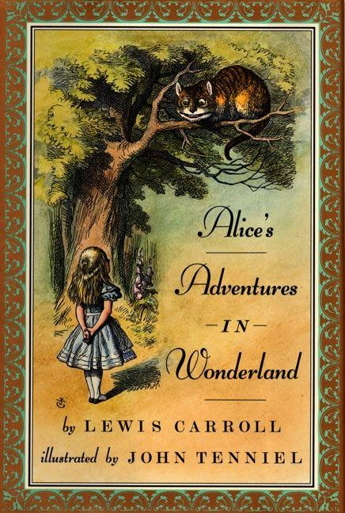
Written by Charles Lutwidge Dodgson, under the pseudonym Lewis Carroll, Alice’s Adventures in Wonderland is one of the most popular novels that belongs to the genre of nonsensical literature. Being a conventional Victorian novel, it has stood the test of time as an enduring classic tale, with all its elements of visual images, fantasy and creative imagination infused within the main story.
The story is about a little girl Alice who craves for adventure when suddenly she witnesses a white rabbit in a waistcoat and curiously follows it down a rabbit hole. But the leap lands her into the fantasy world of dreams where she meets a disappearing cat, enjoys tea with a mad hatter and plays croquet with a queen.

Slide 5
Fantasy

Slide 6

The book is based on a captivating life story of Beatrice Prior. Her dystopian Chicago world has been divided into five factions such as Candor (the honest), Abnegation (the selfless), Dauntless (the brave), Amity (the peaceful) and Erudite (the intelligent). Each faction is dedicated to cultivate a particular virtue and every year 16-year-olds must select any one of these factions, which they have to devote their entire life to.
Even Beatrice has to make a tough decision between staying with her family and being who she really is. When she finally makes her choice, everyone is left with surprise including herself. With the new beginning of her life, Beatrice renames herself Tris while battling the struggle of her new life along with her fellow mates.
All of them have to undergo few physical tests of endurance and psychological simulations to face devastating consequences in future. Following these draining physical and mental examinations, Tris is not able to trust anyone around her but eventually she has to determine who her friends really are.
However, Tris has also kept one secret hidden from everyone as revealing the secret could mean death. But she gradually finds out that the secret could save her loved ones but on a condition that demands her own destruction.

Slide 7
Science Fiction

Slide 8
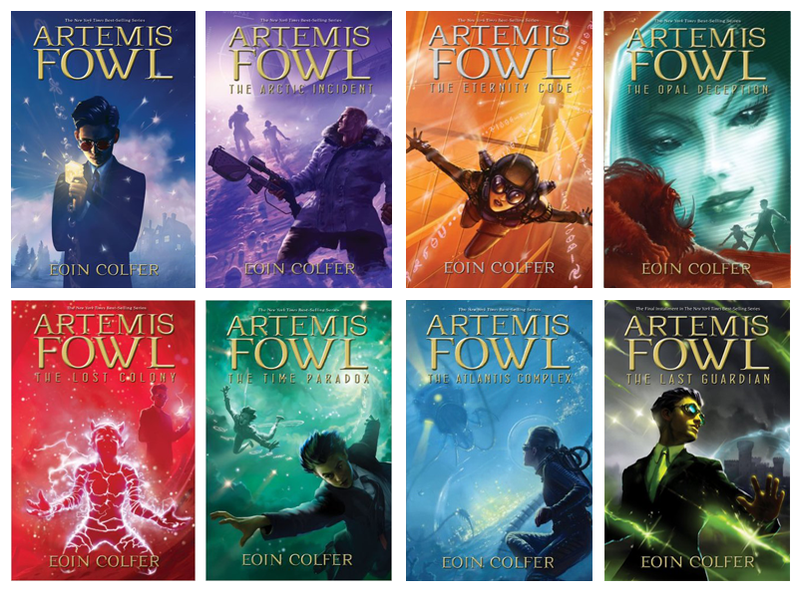
Twelve-year-old Artemis Fowl is a millionaire, a genius, and above all, a criminal mastermind. But even Artemis doesn't know what he's taken on when he kidnaps a fairy, Captain Holly Short of the LEPrecon Unit. These aren't the fairies of bedtime stories—they're dangerous! Full of unexpected twists and turns, Artemis Fowl is a riveting, magical adventure.

Slide 9
Fantasy

Slide 10
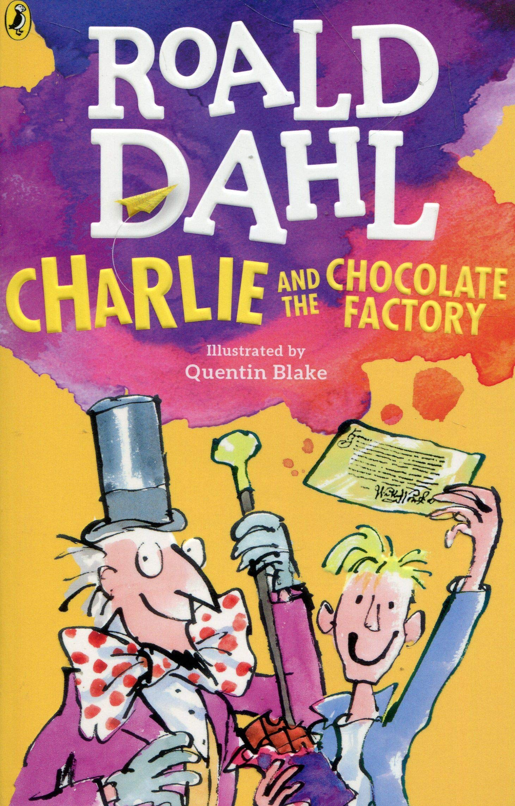
Charlie and the Chocolate Factory captures the adventures of Charlie bucket, who is a poor kid living with his family. Charlie is one of the five kids who gets a golden ticket inside the company, 'Wonka chocolate' owned by Willy Wonka. Those five kids get an entry inside the mysterious Wonka factory. Charlie visits the factory along with his grandfather and gets to experience a lot of adventures inside. The other four kids are later eliminated through hilarious, but painful ways. Will Charlie survive the test? Will he be able to see everything that is to be seen? Readers get a taste of an unusual relationship between a shrewd businessman and a kind kid. In the end, the truth about Wonka is revealed. Why did he host such a competition among kids? The book has all the answers..

Slide 11
Fantasy

Slide 12
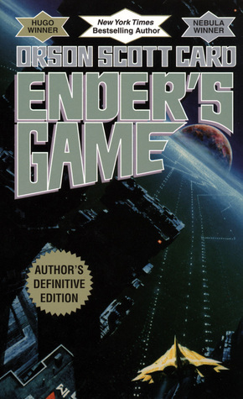
Andrew "Ender" Wiggin thinks he is playing computer simulated war games; he is, in fact, engaged in something far more desperate. The result of genetic experimentation, Ender may be the military genius Earth desperately needs in a war against an alien enemy seeking to destroy all human life. The only way to find out is to throw Ender into ever harsher training, to chip away and find the diamond inside, or destroy him utterly. Ender Wiggin is six years old when it begins. He will grow up fast.
But Ender is not the only result of the experiment. The war with the Buggers has been raging for a hundred years, and the quest for the perfect general has been underway almost as long. Ender's two older siblings, Peter and Valentine, are every bit as unusual as he is, but in very different ways. While Peter was too uncontrollably violent, Valentine very nearly lacks the capability for violence altogether. Neither was found suitable for the military's purpose. But they are driven by their jealousy of Ender, and by their inbred drive for power. Peter seeks to control the political process, to become a ruler. Valentine's abilities turn more toward the subtle control of the beliefs of commoner and elite alike, through powerfully convincing essays. Hiding their youth and identities behind the anonymity of the computer networks, these two begin working together to shape the destiny of Earth-an Earth that has no future at all if their brother Ender fails.

Slide 13
Science Fiction

Slide 14

Celestine North lives a perfect life. She’s a model daughter and sister, she’s well-liked by her classmates and teachers, and she’s dating the impossibly charming Art Crevan.
But then Celestine encounters a situation where she makes an instinctive decision. She breaks a rule and now faces life-changing repercussions. She could be imprisoned. She could be branded. She could be found flawed.
In her breathtaking young adult debut, bestselling author Cecelia Ahern depicts a society where perfection is paramount and flaws lead to punishment. And where one young woman decides to take a stand that could cost her everything.

Slide 15
Science Fiction

Slide 16
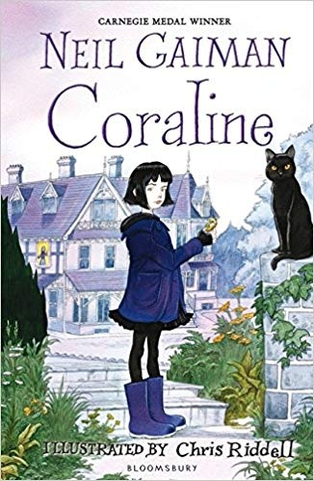
There is something strange about Coraline’s new home. It’s not the mist, or the cat that always seems to be watching her, nor the signs of danger that Miss Spink and Miss Forcible, her new neighbours, read in the tea leaves. It’s the other house – the one behind the old door in the drawing room. Another mother and father with black-button eyes and papery skin are waiting for Coraline to join them there. And they want her to stay with them. For ever. She knows that if she ventures through that door, she may never come back.

Slide 17
Fantasy

Slide 18
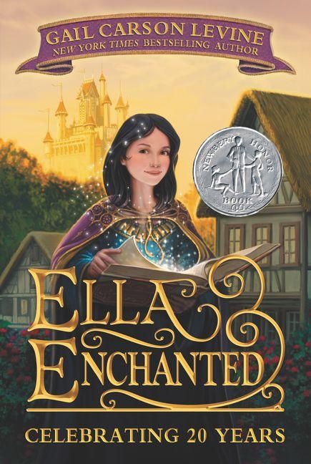
At birth, Ella is inadvertently cursed by an imprudent young fairy named Lucinda, who bestows on her the "gift" of obedience. Anything anyone tells her to do, Ella must obey. Another girl might have been cowed by this affliction, but not feisty Ella: "Instead of making me docile, Lucinda's curse made a rebel of me. Or perhaps I was that way naturally." When her beloved mother dies, leaving her in the care of a mostly absent and avaricious father, and later, a loathsome stepmother and two treacherous stepsisters, Ella's life and well-being seem to be in grave peril. But her intelligence and saucy nature keep her in good stead as she sets out on a quest for freedom and self-discovery as she tries to track down Lucinda to undo the curse, fending off ogres, befriending elves, and falling in love with a prince along the way. Yes, there is a pumpkin coach, a glass slipper, and a happily ever after, but this is the most remarkable, delightful, and profound version of Cinderella you'll ever read.

Slide 19
Fantasy

Slide 20
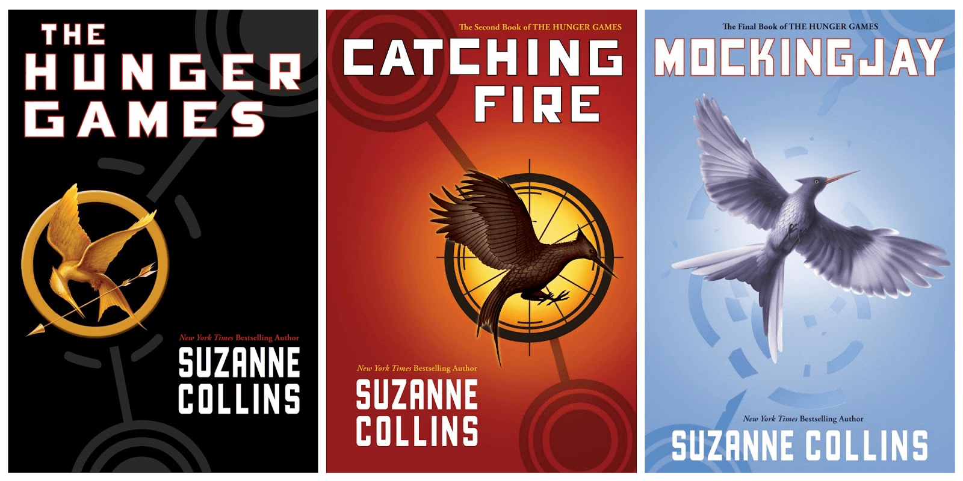
Could you survive on your own, in the wild, with everyone out to make sure you don't live to see the morning?
In the ruins of a place once known as North America lies the nation of Panem, a shining Capitol surrounded by twelve outlying districts. The Capitol is harsh and cruel and keeps the districts in line by forcing them all to send one boy and one girl between the ages of twelve and eighteen to participate in the annual Hunger Games, a fight to the death on live TV. Sixteen-year-old Katniss Everdeen, who lives alone with her mother and younger sister, regards it as a death sentence when she is forced to represent her district in the Games. But Katniss has been close to dead before - and survival, for her, is second nature. Without really meaning to, she becomes a contender. But if she is to win, she will have to start making choices that weigh survival against humanity and life against love.
New York Times bestselling author Suzanne Collins delivers equal parts suspense and philosophy, adventure and romance, in this searing novel set in a future with unsettling parallels to our present.

Slide 21
Science Fiction

Slide 22
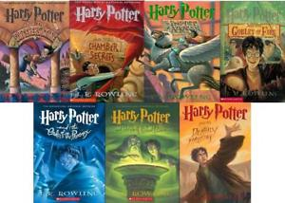
"Turning the envelope over, his hand trembling, Harry saw a purple wax seal bearing a coat of arms; a lion, an eagle, a badger and a snake surrounding a large letter 'H'."
Harry Potter has never even heard of Hogwarts when the letters start dropping on the doormat at number four, Privet Drive. Addressed in green ink on yellowish parchment with a purple seal, they are swiftly confiscated by his grisly aunt and uncle. Then, on Harry's eleventh birthday, a great beetle-eyed giant of a man called Rubeus Hagrid bursts in with some astonishing news: Harry Potter is a wizard, and he has a place at Hogwarts School of Witchcraft and Wizardry. An incredible adventure is about to begin!

Slide 23
Fantasy

Slide 24
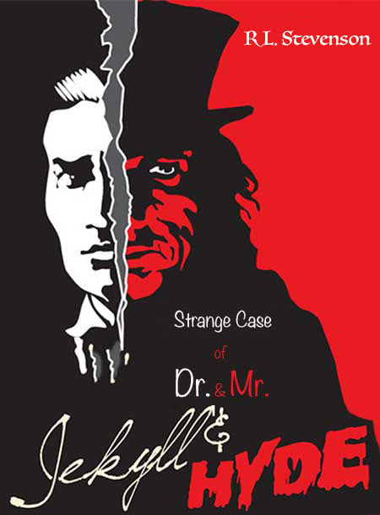
As you stroll along the streets of London in the company of lawyer Utterson and his distant relative Enfield, the latter narrates a gruesome tale of assault he had witnessed some months ago. the tale describes a dreadful looking sinister man, Mr. Hyde, who ruthlessly tramples a young girl and disappears behind a door. a moment later he reemerges to pay off her relatives with a cheque drawn from the account of a reputable gentleman, later identified to be Utterson’s client and old friend, Dr. Jekyll.
Who is Mr. Hyde?
Who is Dr. Jekyll?
Is there a mysterious connection between the two?
Read Stevenson’s thrilling and titillating masterpiece, the Strange Case of Dr. Jekyll and Mr. Hyde, to knit up the jigsaw puzzle and unveil the suspense.
A harrowing tale of good and evil, this classic novella describes the fundamental dichotomy of the 19th century—outward respectability and inward lust, a duality for which it has been noted as ‘one of the best guidebooks of the Victorian era’ and remains one of the most famous stories of English literature.

Slide 25
Science Fiction

Slide 26
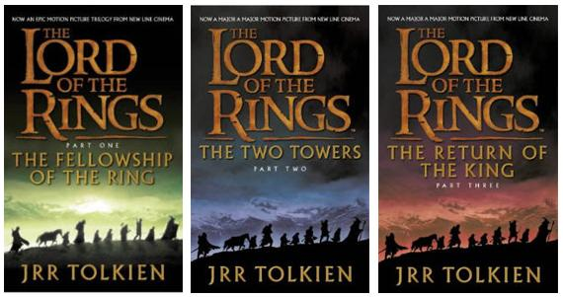
One Ring to rule them all, One Ring to find them, One Ring to bring them all and in the darkness bind them.
In ancient times the Rings of Power were crafted by the Elven-smiths, and Sauron, The Dark Lord, forged the One Ring, filling it with his own power so that he could rule all others. But the One Ring was taken from him, and though he sought it throughout Middle-earth, it remained lost to him. After many ages it fell into the hands of Bilbo Baggins, as told in The Hobbit.
In a sleepy village in the Shire, young Frodo Baggins finds himself faced with an immense task, as his elderly cousin Bilbo entrusts the Ring to his care. Frodo must leave his home and make a perilous journey across Middle-earth to the Cracks of Doom, there to destroy the Ring and foil the Dark Lord in his evil purpose.

Slide 27
Fantasy

Slide 28

Six unforgettable kids — with no families, no homes — are running for their lives. Max Ride and her best friends have the ability to fly. And that's just the beginning of their amazing powers. But they don't know where they come from, who's hunting them, why they are different from all other humans... and if they're meant to save mankind — or destroy it.

Slide 29
Science Fiction

Slide 30

If you ain’t scared, you ain’t human.
When Thomas wakes up in the lift, the only thing he can remember is his name. He’s surrounded by strangers—boys whose memories are also gone.
Nice to meet ya, shank. Welcome to the Glade.
Outside the towering stone walls that surround the Glade is a limitless, ever-changing maze. It’s the only way out — and no one’s ever made it through alive.
Everything is going to change.
Then a girl arrives. The first girl ever. And the message she delivers is terrifying.
Remember. Survive. Run.

Slide 31
Science Fiction

Slide 32
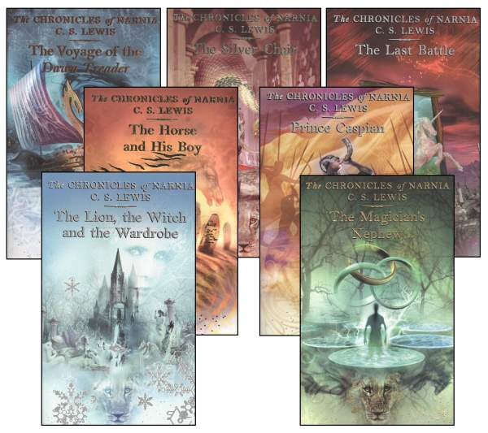
Narnia… the land beyond the wardrobe door, a secret place frozen in eternal winter, a magical country waiting to be set free.
Lucy is the first to find the secret of the wardrobe in the professor's mysterious old house. At first her brothers and sister don't believe her when she tells of her visit to the land of Narnia. But soon Edmund, then Peter and Susan step through the wardrobe themselves. In Narnia they find a country buried under the evil enchantment of the White Witch. When they meet the Lion Aslan, they realize they've been called to a great adventure and bravely join the battle to free Narnia from the Witch's sinister spell.

Slide 33
Fantasy

Slide 34

To everyone at Meridian High School, fourteen-year-old Michael Vey is nothing special, just the kid who has Tourette’s syndrome. But in truth, Michael is extremely special—he has electric powers. Michael thinks he is unique until he discovers that a cheerleader named Taylor has the same mysterious powers. With the help of Michael’s friend, Ostin, the three of them set out to discover how Michael and Taylor ended up with their abilities, and their investigation soon brings them to the attention of a powerful group who wants to control the electric teens—and through them, the world.

Slide 35
Science Fiction

Slide 36
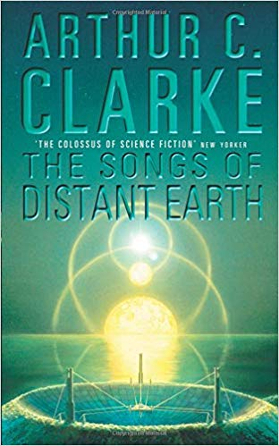
Just a few islands in a planetwide ocean, Thalassa was a veritable paradise — home to one of the small colonies founded centuries before by robot Mother Ships when the Sun had gone nova and mankind had fled Earth.
Mesmerized by the beauty of Thalassa and overwhelmed by its vast resources, the colonists lived an idyllic existence, unaware of the monumental evolutionary event slowly taking place beneath their seas...
Then the Magellan arrived in orbit carrying one million refugees from the last, mad days on Earth. And suddenly uncertainty and change had come to the placid paradise that was Thalassa.

Slide 37
Science Fiction

Slide 38
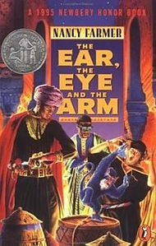
General Matsika's children steal out of the house on a forbidden adventure--and disappear. In Zimbabwe, in the year 2194, the children's parents call in Africa's most unusual detectives – the Ear, the Eye and the Arm – who have powers far beyond those of other human beings. The children must avoid the evils of the past, the technology of the future, and a motley assortment of criminals in order to return home safely.

Slide 39
Science Fiction

Slide 40
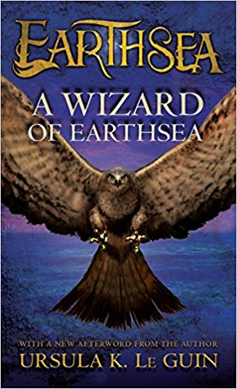
Ged was the greatest sorcerer in all Earthsea, but once he was called Sparrowhawk, a reckless youth, hungry for power and knowledge, who tampered with long-held secrets and loosed a terrible shadow upon the world. This is the tale of his testing, how he mastered the mighty words of power, tamed an ancient dragon, and crossed death's threshold to restore the balance.

Slide 41
Fantasy

Slide 42
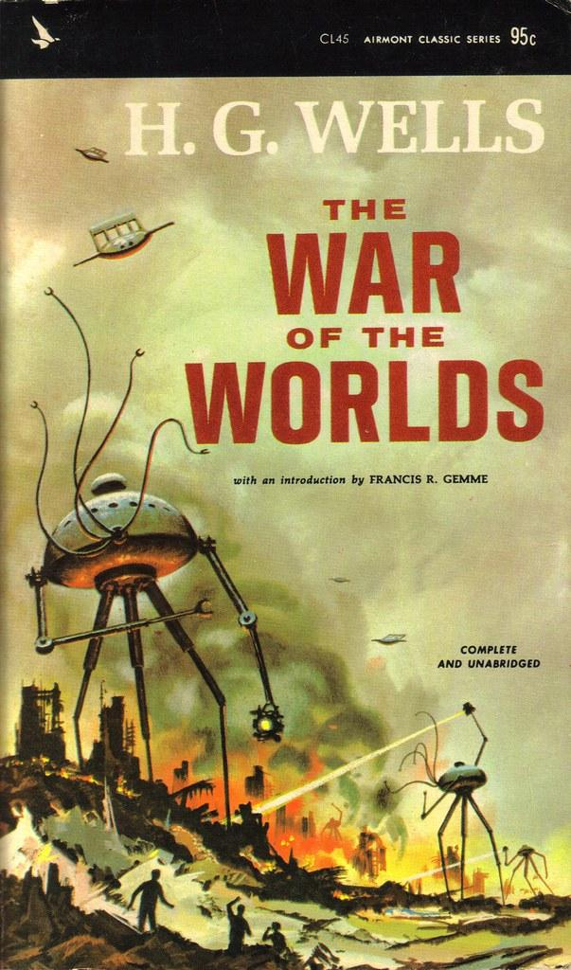
Even long before man had learned to fly, H.G. Wells wrote this story of the Martian attack on England. These unearthly creatures arrive in huge cylinders, from which they escape as soon as the metal is cool. The first falls near Woking and is regarded as a curiosity rather than a danger until the Martians climb out of it and kill many of the gaping crowd with a Heat-Ray. These unearthly creatures have heads four feet in diameter and colossal round bodies, and by manipulating two terrifying machines – the Handling Machine and the Fighting Machine – they are as versatile as humans and at the same time insuperable. They cause boundless destruction. The inhabitants of the Earth are powerless against them, and it looks as if the end of the World has come. But there is one factor which the Martians, in spite of their superior intelligence, have not reckoned on. It is this which brings about a miraculous conclusion to this famous work of the imagination.

Slide 43
Science Fiction

Slide 44
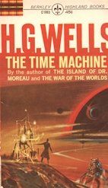
“I’ve had a most amazing time....”
So begins the Time Traveller’s astonishing firsthand account of his journey 800,000 years beyond his own era—and the story that launched H.G. Wells’s successful career and earned him his reputation as the father of science fiction. With a speculative leap that still fires the imagination, Wells sends his brave explorer to face a future burdened with our greatest hopes...and our darkest fears. A pull of the Time Machine’s lever propels him to the age of a slowly dying Earth. There he discovers two bizarre races—the ethereal Eloi and the subterranean Morlocks—who not only symbolize the duality of human nature, but offer a terrifying portrait of the men of tomorrow as well.

Slide 45
Science Fiction

Slide 46
Definitions
space
life on other planets
time travel
Science Fiction
fiction
mostly set in future
with imaginary scientific or technological developments
sometimes major social or environmental changes

Slide 47
Definitions
magic
mythical creatures
talking animals
Fantasy
fiction = imaginary
involving magic and adventure
in an setting other than the real world

Slide 48
Science fiction and fantasy can sometimes appear very similar.
“Time travel, for instance, can occur in both science fiction and fantasy.
If the time travel occurred by magic, it’s fantasy; if it occurred by means of advanced technology, it’s science fiction.”
The Book Whisperer by Donalyn Miller

Slide 49
Science fiction and fantasy can sometimes appear very similar.
“Science fiction usually has a scientific premise at its core. For example, Jurassic Park, by Michael Crichton, explores cloning.
While science fiction draws on and extrapolates from what we know about reality and science, fantasy invents what does not (and likely could not) exist in our reality.”
Gotham Writers

Slide 50
Make Additions and Corrections Based on Today’s Lesson
 | Fantasy | Science Fiction
characters
settings
plotlines (storylines)
Notes:
“I agree that if a book has a wizard or magic user in it, then it has to be fantasy, but do all fantasy books have these kinds of characters? Can anyone give me an example of a book that doesn’t have a wizard in it, but is still fantasy?”
books that have talking animals in them, such as Charlotte’s Web and Redwall, are fantasy
urge students to avoid generalizations by staying away from words such as all and every when making their suggestions. twelve-year-olds can still be fairly literal, explain that there are subtle distinctions even within a genre.
“Honestly, fantasy books could have any type of character you could imagine, including everyday people, but what we are looking for are character types that cannot occur in any genre but fantasy.”
time travel by magic determines that a book is fantasy, whereas time travel by means of advanced technology renders it science fiction.
historical events have to be the center of a plot to make a book historical fiction.

