Slide 1
Lesson 5
Science Fiction vs. Dystopia

Slide 2
First, the definition of DYSTOPIA
an imaginary world
which is extremely difficult
with terrible injustice and suffering
For example: It’s the year 2700. The Earth is uninhabitable because it’s covered in towers of garbage.
The opposite of DYSTOPIA is UTOPIA, an imaginary world which is perfect and everyone is happy.
Notes:
https://dictionary.cambridge.org/us/dictionary/english/dystopia#:~:text=a%20very%20bad%20or%20unfair,covered%20in%20towers%20of%20garbage.

Slide 3


Two Famous Examples of DYSTOPIA

Slide 4
Aldous Huxley's profoundly important classic of world literature, Brave New World is a searching vision of an unequal, technologically-advanced future where humans are genetically bred, socially indoctrinated, and pharmaceutically anesthetized to passively uphold an authoritarian ruling order–all at the cost of our freedom, full humanity, and perhaps also our souls.

Slide 5
A masterpiece of rebellion and imprisonment where war is peace freedom is slavery and Big Brother is watching Thought Police Big Brother Orwellian These words have entered our vocabulary because of George Orwell's classic dystopian novel 1984 The story of one man's nightmare odyssey as he pursues a forbidden love affair through a world ruled by warring states and a power structure that controls not only information but also individual thought and memory 1984 is a prophetic haunting tale More relevant than ever before 1984 exposes the worst crimes imaginable the destruction of truth freedom and individuality.

Slide 6
Let’s recollect:
space
life on other planets
time travel
Science Fiction
fiction
mostly set in future
with imaginary scientific or technological developments
sometimes major social or environmental changes

Slide 7
The source of confusion between science fiction and dystopia:
Very often, the future in science fiction is presented in a dystopian setting.
So, science fiction is OFTEN dystopian.

Slide 8
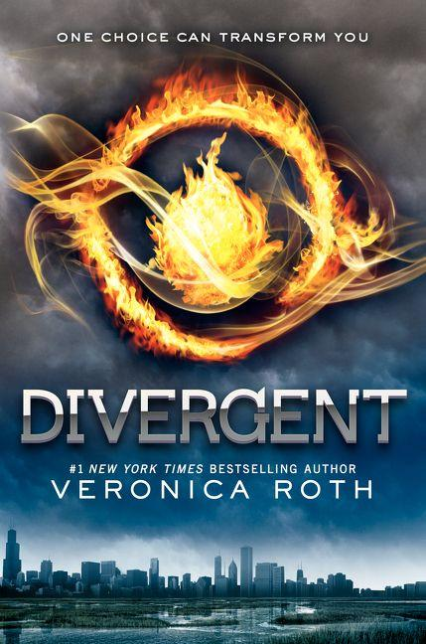
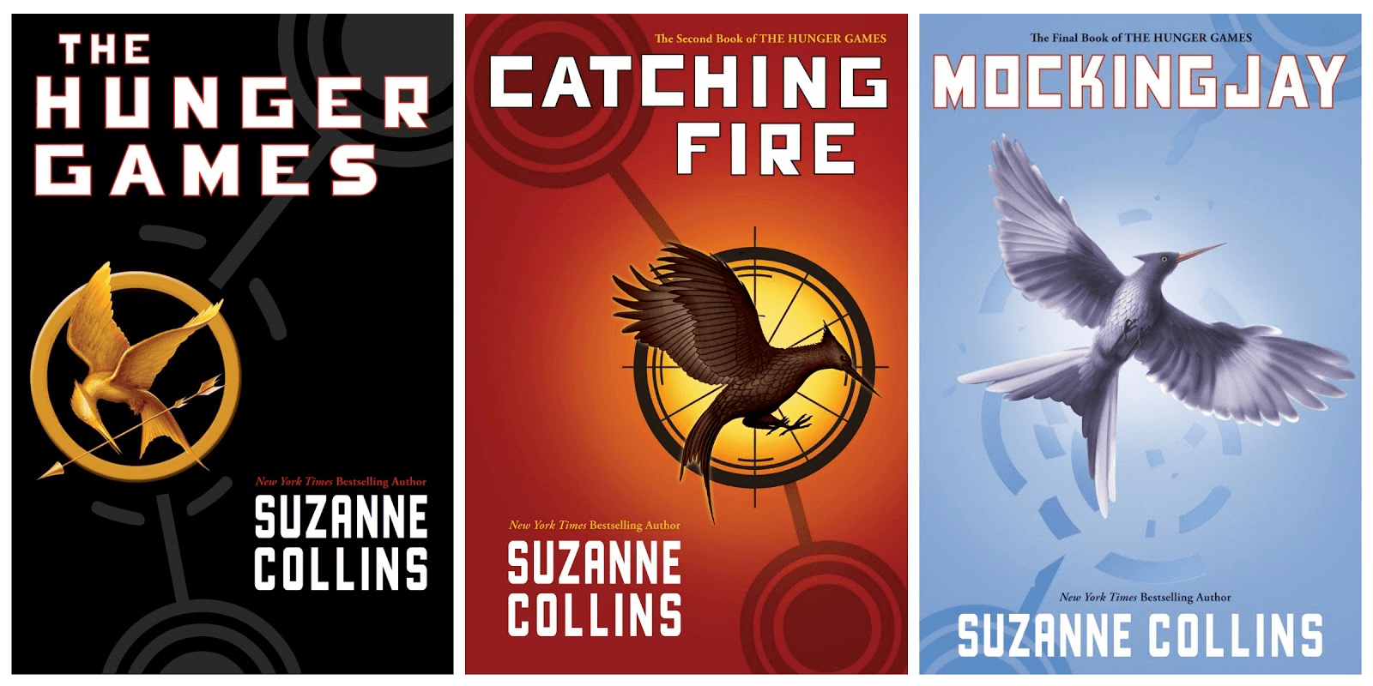

Slide 9
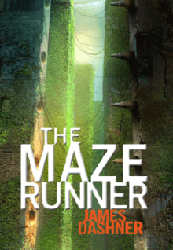
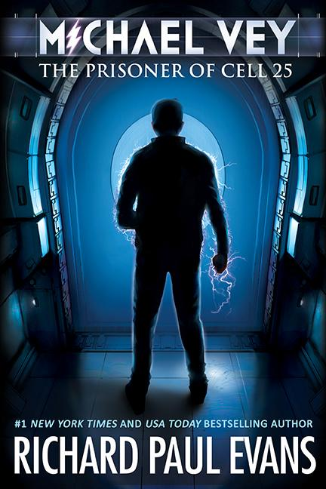

Slide 11
Many science fiction stories are NOT dystopian.

Slide 12
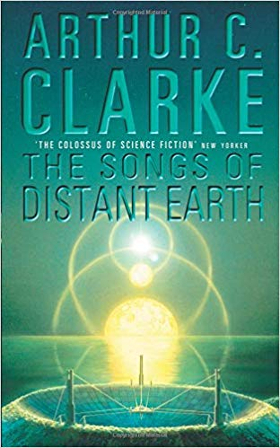

Slide 13
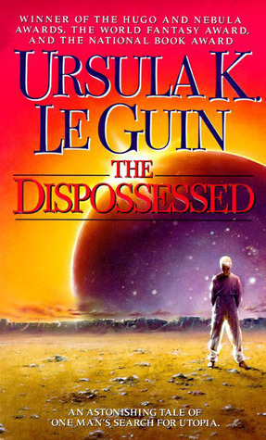
Shevek, a brilliant physicist, decides to take action. He will seek answers, question the unquestionable, and attempt to tear down the walls of hatred that have isolated his planet of anarchists from the rest of the civilized universe. To do this dangerous task will mean giving up his family and possibly his life — Shevek must make the unprecedented journey to the utopian mother planet, Urras, to challenge the complex structures of life and living, and ignite the fires of change.

Slide 14
Science Fiction
and
Utopia

Slide 15
science
fiction
both
dystopia

Slide 16
To Conclude
Most books belong to multiple genres.
They are complex, just like us, and resist simple classification.
The question of whether a book is, say, more science fiction or more dystopian,
and hence which shelf it must belong to
is ultimately at the discretion of the reader.

